Slide 1
Nutrition & Vision It’s more than just carrots
2600 Netherland Avenue, Bronx, NY 10463 November 15, 2021
Presented by Maudene Nelson, RDN
Contacts: Barbara Denson & Margie Schustack
RSS, Inc.
2600 Netherland Ave.
(718) 884-5900
Join Zoom Meeting https://us02web.zoom.us/j/84707567767

Slide 2
In this presentation we will look beyond the importance of eating carrots to nourish your eyes.
the Age-Related Eye Disease Study
zinc copper
vitamin C vitamin E
beta carotene omega-3 fat
lutein & zeaxanthin selenium

Slide 3
How the eye works ….
The eye is vulnerable to oxidation & inflammation … more than other organs & tissues in the body …

Slide 4
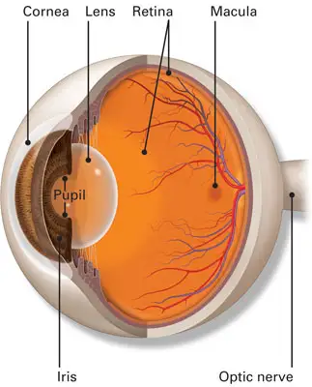

Slide 5
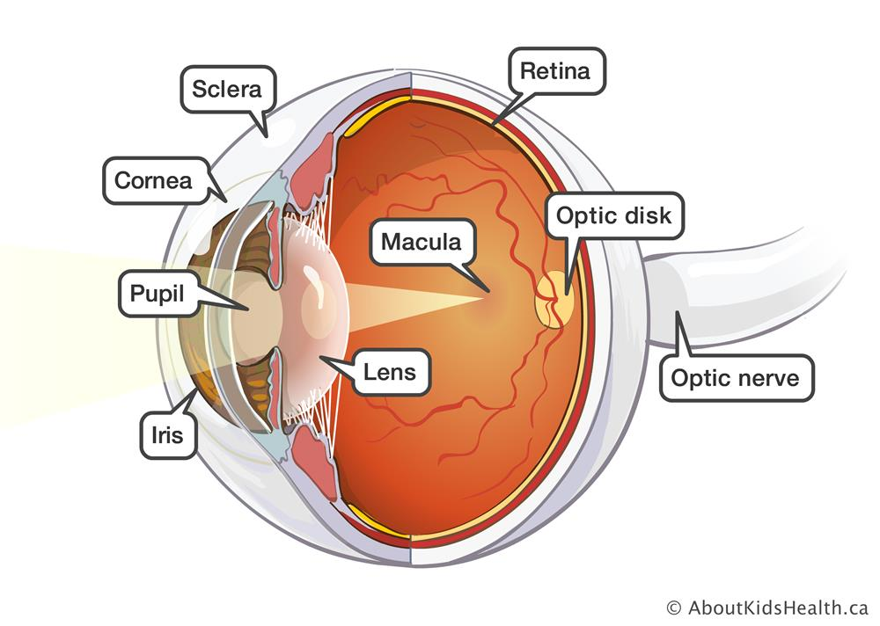

Slide 6
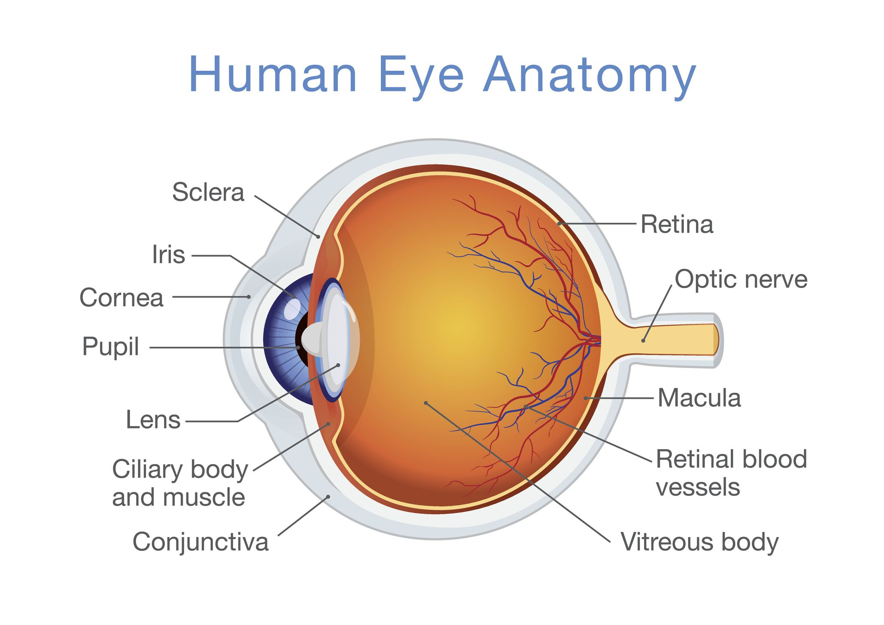

Slide 7
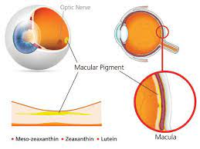
Lutein and Zeaxanthin
may prevent cataracts & macular degeneration
protective barriers
light spectrum
red to blue/violet
(more energy …
blue light is toxic for the retina
prevent peroxidation on long chain fats

Slide 8
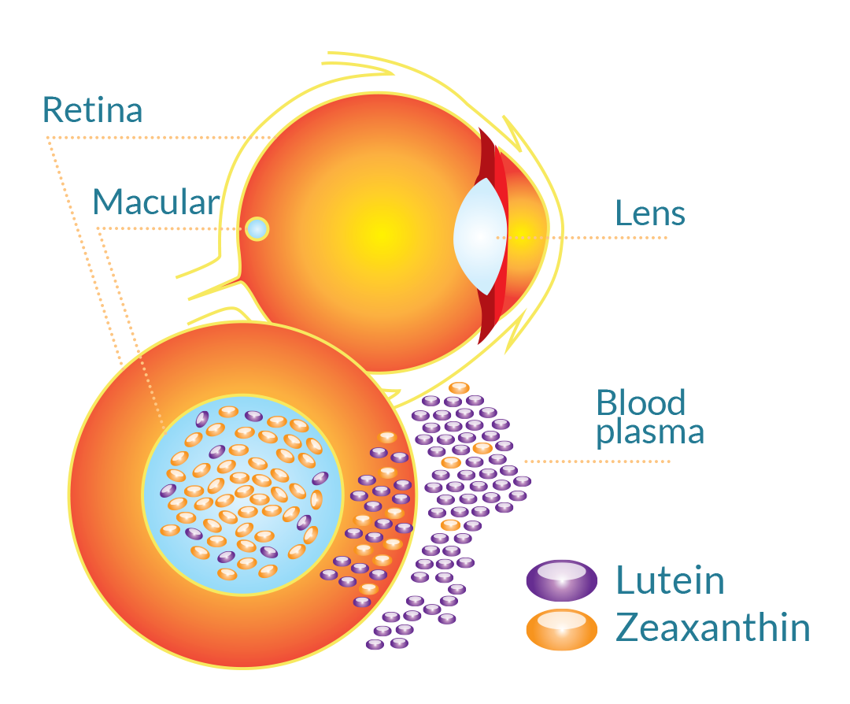

Slide 9
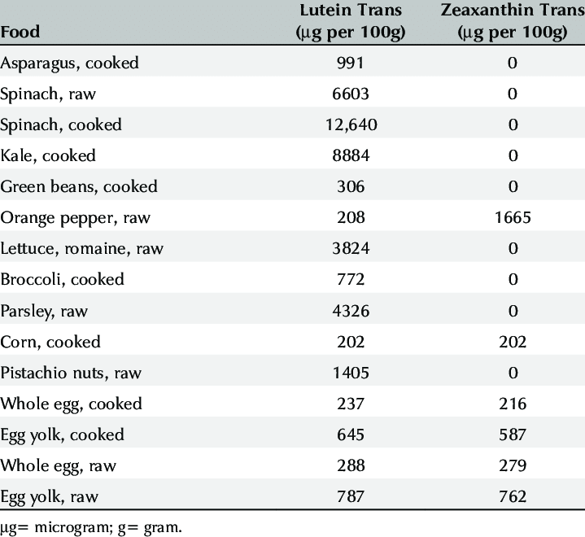
https://www.researchgate.net/figure/Lutein-and-zeaxanthin-levels-found-in-foods-48_tbl1_327139695

Slide 10
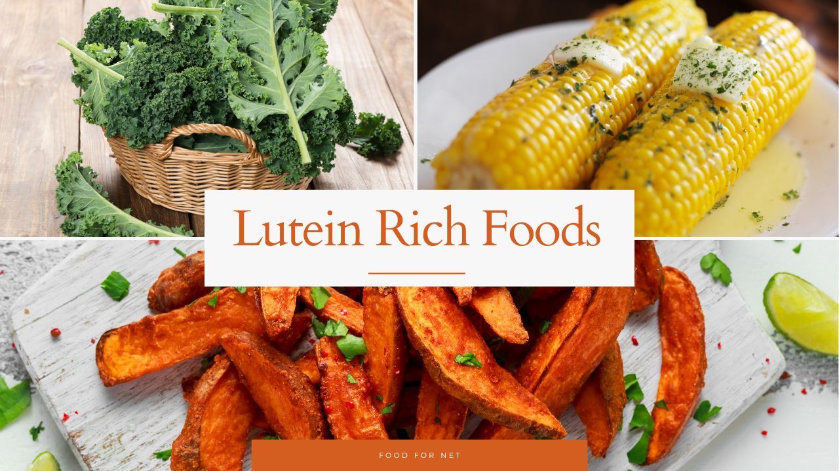
https://foodfornet.com/lutein-rich-foods/

Slide 11
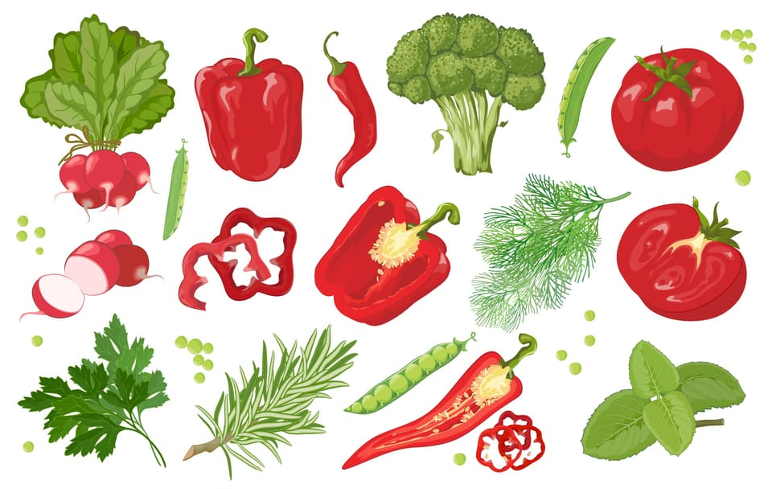

Slide 12
What Others?
antioxidants may reduce risk of cataracts & macular degeneration.
vitamin A protects against blindness, & vitamin C may play a role in preventing or alleviating glaucoma.
anti-inflammatory omega-3 essential fatty acids appear to help the eye in a variety of ways, from alleviating symptoms of dry eye syndrome to guarding against macular damage.

Slide 13
Zinc
Helps vitamin A reduce the risk of night blindness; may play a role in reducing risk of advanced AMD.

Slide 14
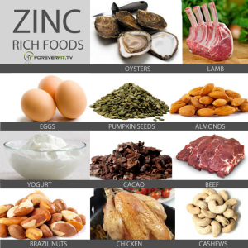
foods rich in zinc – oysters, cashews, liver, beef & egg yolks
https://www.health.harvard.edu/blog/nutritional-strategies-to-ease-anxiety-201604139441
https://i.pinimg.com/originals/f7/ee/7d/f7ee7d11fd6ac6847d67fde158576b9c.jpg

Slide 15
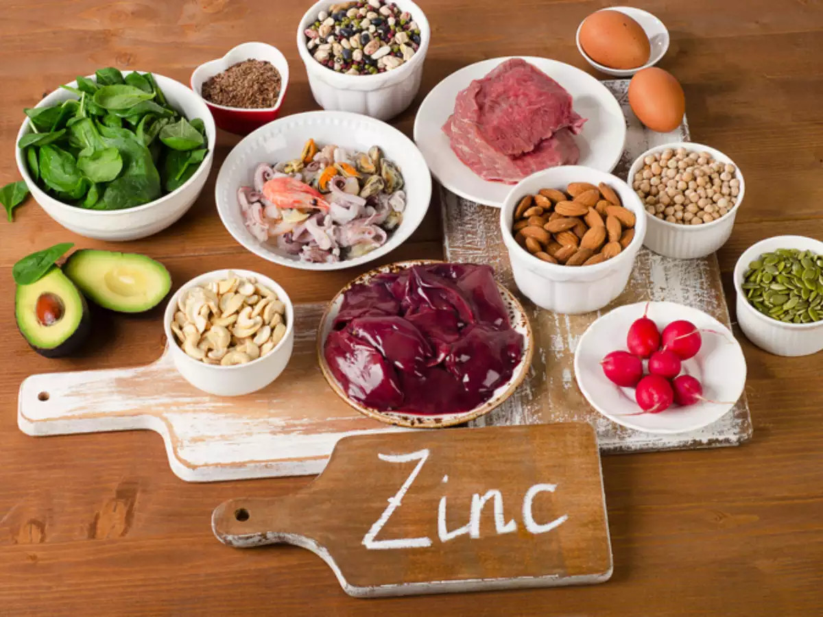

Slide 16
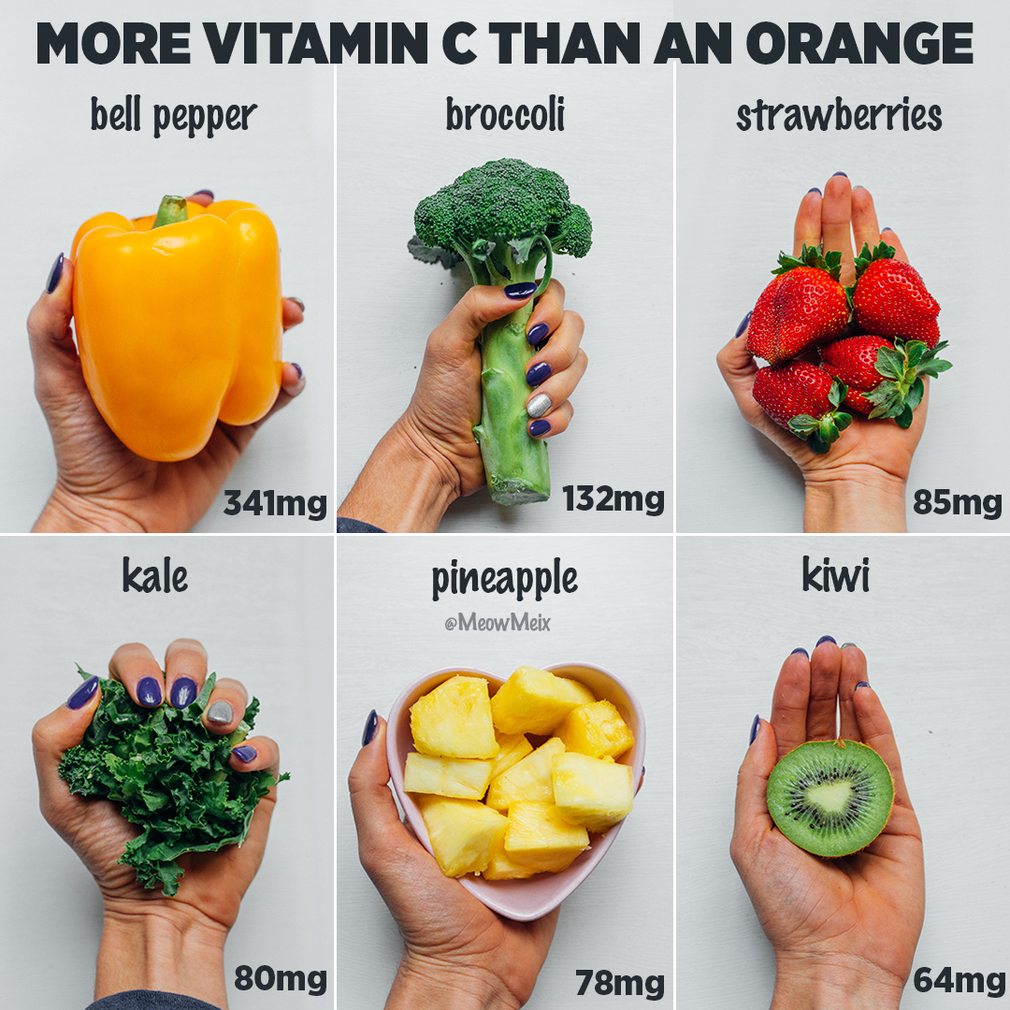
Vitamin C
As an antioxidant, may reduce the risk of cataracts and macular degeneration.
Potatoes
Melons
Oranges
grapefruits

Slide 17
Beta carotene
When taken in combination with zinc and vitamins C and E, beta-carotene may reduce the progression of macular degeneration.
Food sources: Carrots, sweet potatoes, spinach, kale, butternut squash.

Slide 18
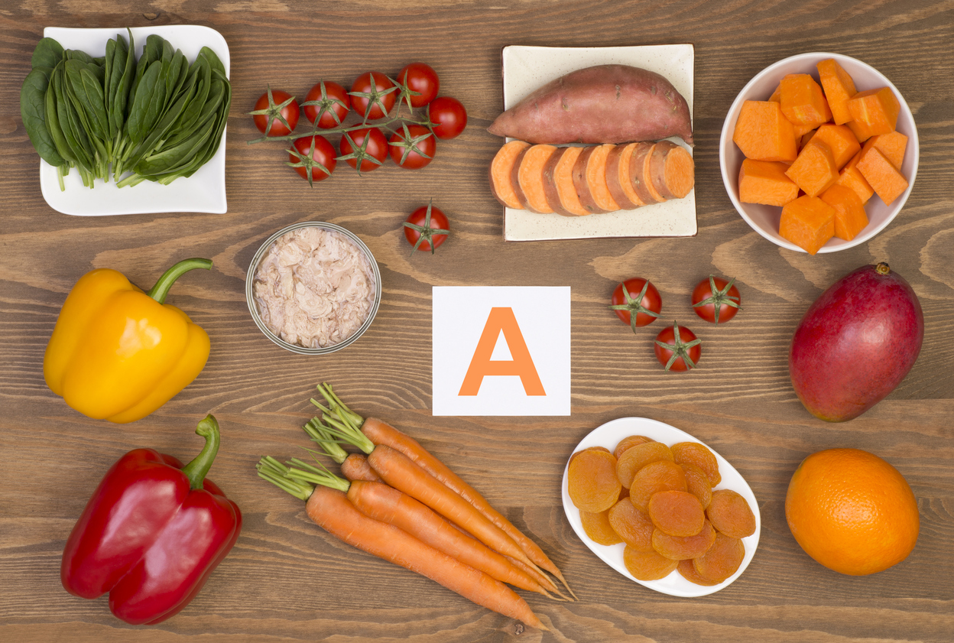

Slide 19
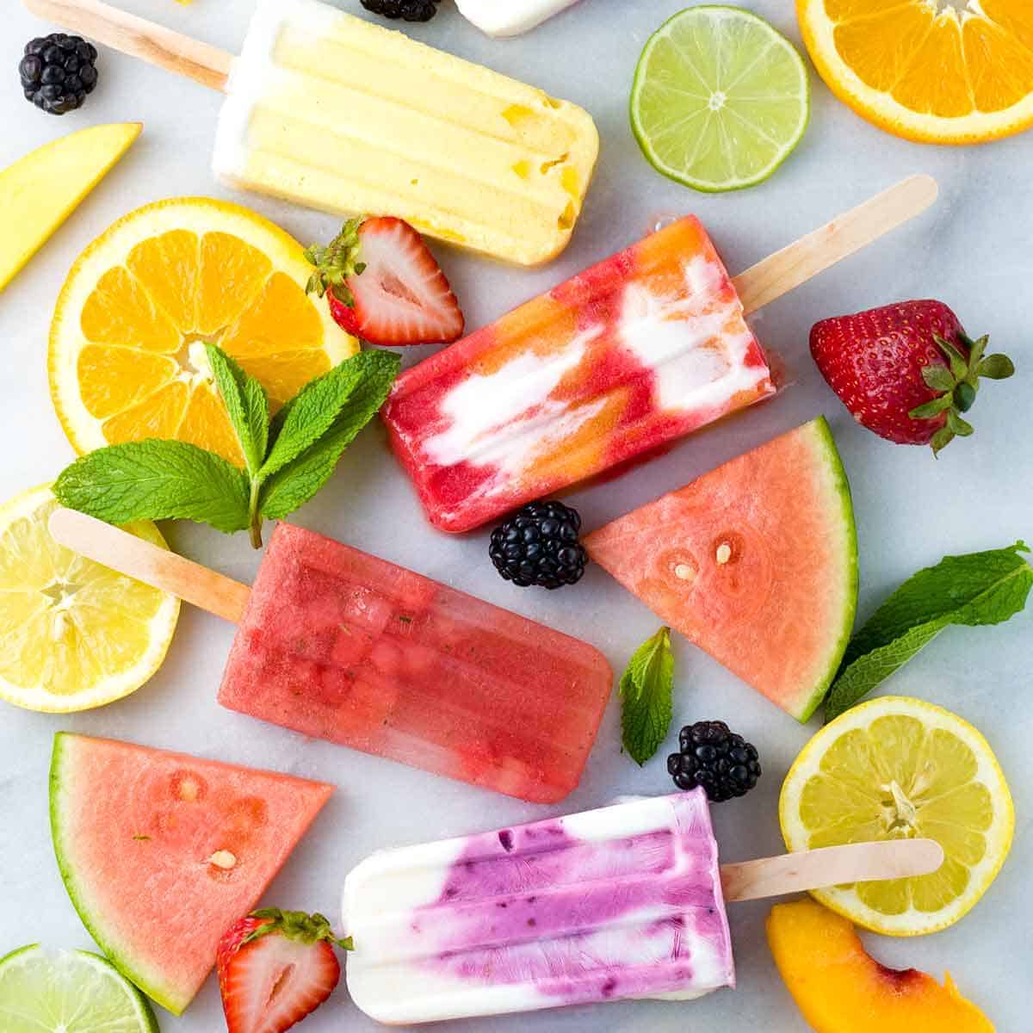
https://www.jessicagavin.com/make-your-own-homemade-fruit-popsicles/

Slide 20
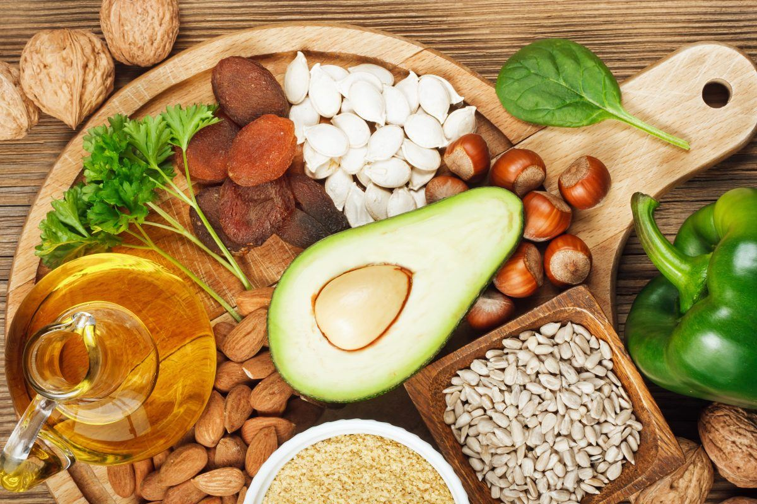
Vitamin E
When combined with carotenoids & vitamin C, may reduce the risk of advanced AMD.
https://www.hsph.harvard.edu/nutritionsource/vitamin-e/

Slide 21
Vitamin D
May reduce the risk of macular degeneration.
Food sources: Salmon, sardines, mackerel, milk; orange juice fortified with vitamin D.
The best source of vitamin D is exposure to sunlight. Ultraviolet radiation from the sun stimulates production of vitamin D in human skin,

Slide 22
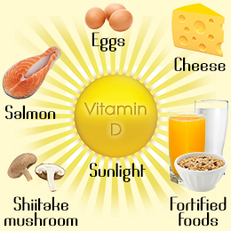
Reference: "Vitamin D Deficiency Is Associated With Low Mood and Worse Cognitive Performance in Older Adults," Wilkins CH, Sheline YI, et al, Am J Geriatr Psychiatry. 2006; 14(12): 1032-1040. (Address: Department of Medicine, Division of Geriatrics and Nutritional Science, Washington University School of Medicine, St. Louis, MO, USA).

Slide 23
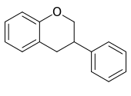
Bioflavonoids
Eye benefits of bioflavonoids: May protect against cataracts and macular degeneration.
What are they? Plant chemicals with a
specific structure; often yellow; some in the rind of citrus
Food sources: Tea, red wine, citrus fruits, bilberries, blueberries, cherries, legumes, soy products.

Slide 24
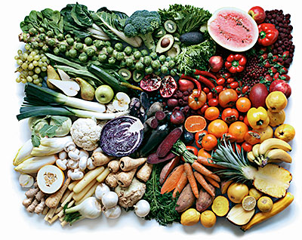
Colorful Plants

Slide 25
Omega-3 Fatty Acids
May help prevent macular degeneration (AMD) and dry eyes & alleviating symptoms of dry eye syndrome to
Food sources: Cold-water fish such as salmon, mackerel and herring; fish oil supplements, freshly ground flaxseeds, walnuts.
American Heart Association recommends approximately 1,000 mg daily.

Slide 26
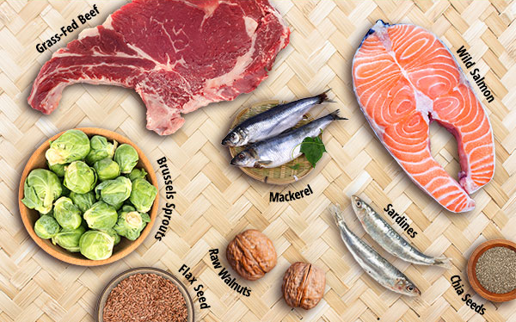
Omega-3 = DHA, EPA, & ALA
Cold water fish will give DHA & EPA … land plants, such as walnuts & flax seeds
https://www.health.harvard.edu/blog/nutritional-strategies-to-ease-anxiety-201604139441

Slide 27
Omega-3 fatty acids
important for proper visual development and retinal function
in pre-term and full-term infants suggest that getting enough omega-3 fatty acids in the diet is essential for optimal visual development
can help reduce inflammation, enhance tear production and support the eye’s oily outer layer.

Slide 28
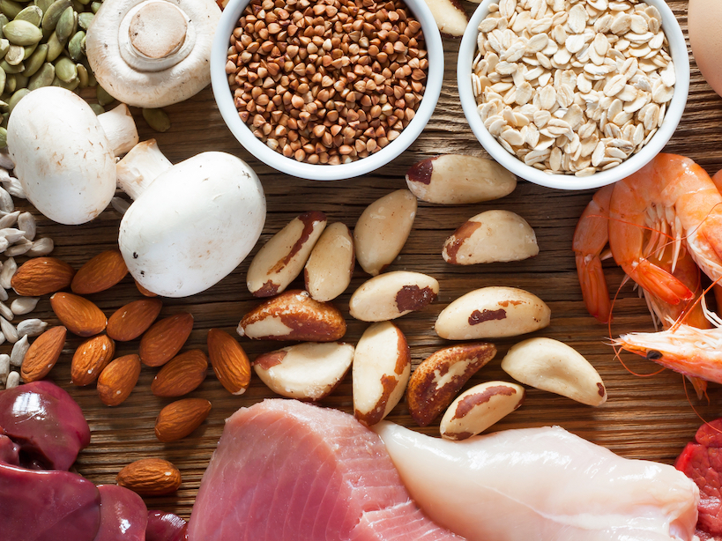
Selenium
When combined with carotenoids and vitamins C and E, may reduce risk of advanced AMD.

Slide 29
… Selenium
is a component of selenoproteins and enzymes.
have antioxidant properties that help to break down peroxides …
… can damage tissues & DNA, leading to inflammation
https://www.hsph.harvard.edu/nutritionsource/selenium/

Slide 30
Take “Eye Vitamins” … ?
In general, it's best to obtain most nutrients through a healthy diet, including at least two servings of fish per week and plenty of colorful fruits and vegetables
Lutein & Zeaxanthin with DHA are supported by research
be sure to discuss this with your optometrist or ophthalmologist.

Slide 31
How do you know you’re getting quality?

Slide 33
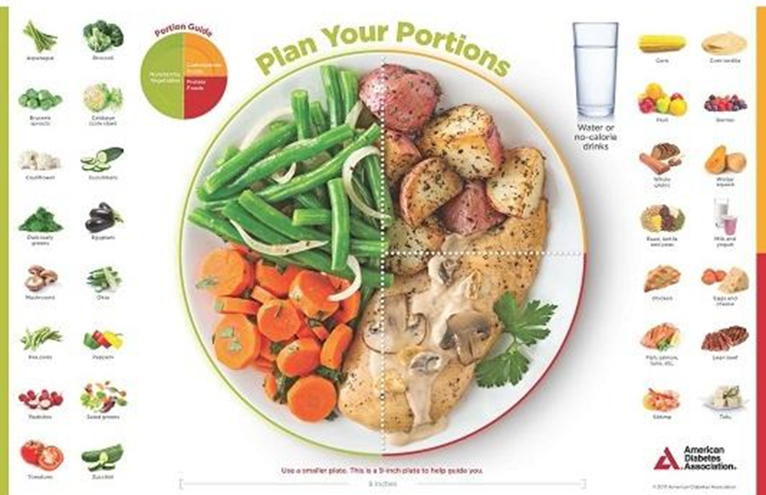
For all of these nutrients you use the plate method … and ...

Slide 34
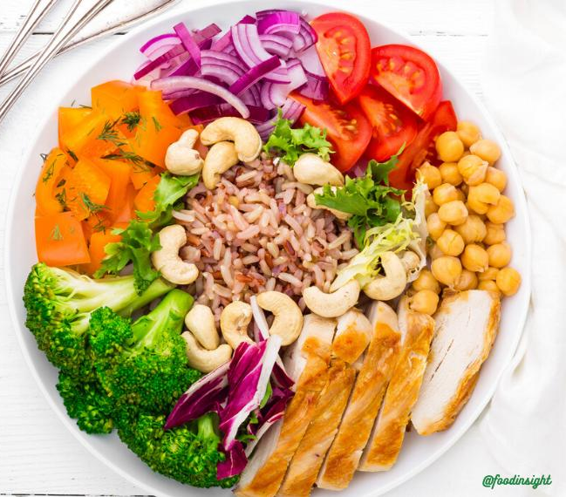

Slide 35
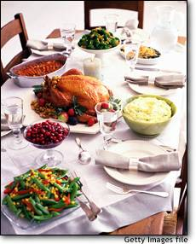
1730 Poor Farmers’ Almanac: “Eat chiefly from the garden, the Orchard, and the Henhouse.”

Slide 36
References
https://health.howstuffworks.com/mental-health/human-nature/perception/eye.htm
https://www.allaboutvision.com/nutrition/nutrition_summary.htm
https://www.aboutkidshealth.ca/Article?contentid=1941&language=English#
https://en.wikipedia.org/wiki/Macula_of_retina#/media/File:Blausen_0389_EyeAnatomy_02.png
https://en.wikipedia.org/wiki/Macula_of_retina
https://www.aao.org/eye-health/anatomy/macula-6
https://www.reviewofoptometry.com/CMSDocuments/2019/09/ro0319_MacuHealth.pdf

