Slide 1
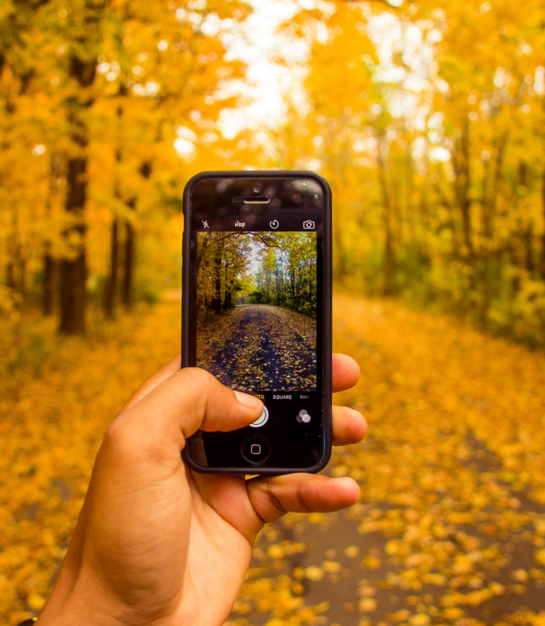
Smartphone Photography Tips
The Basics

Slide 2
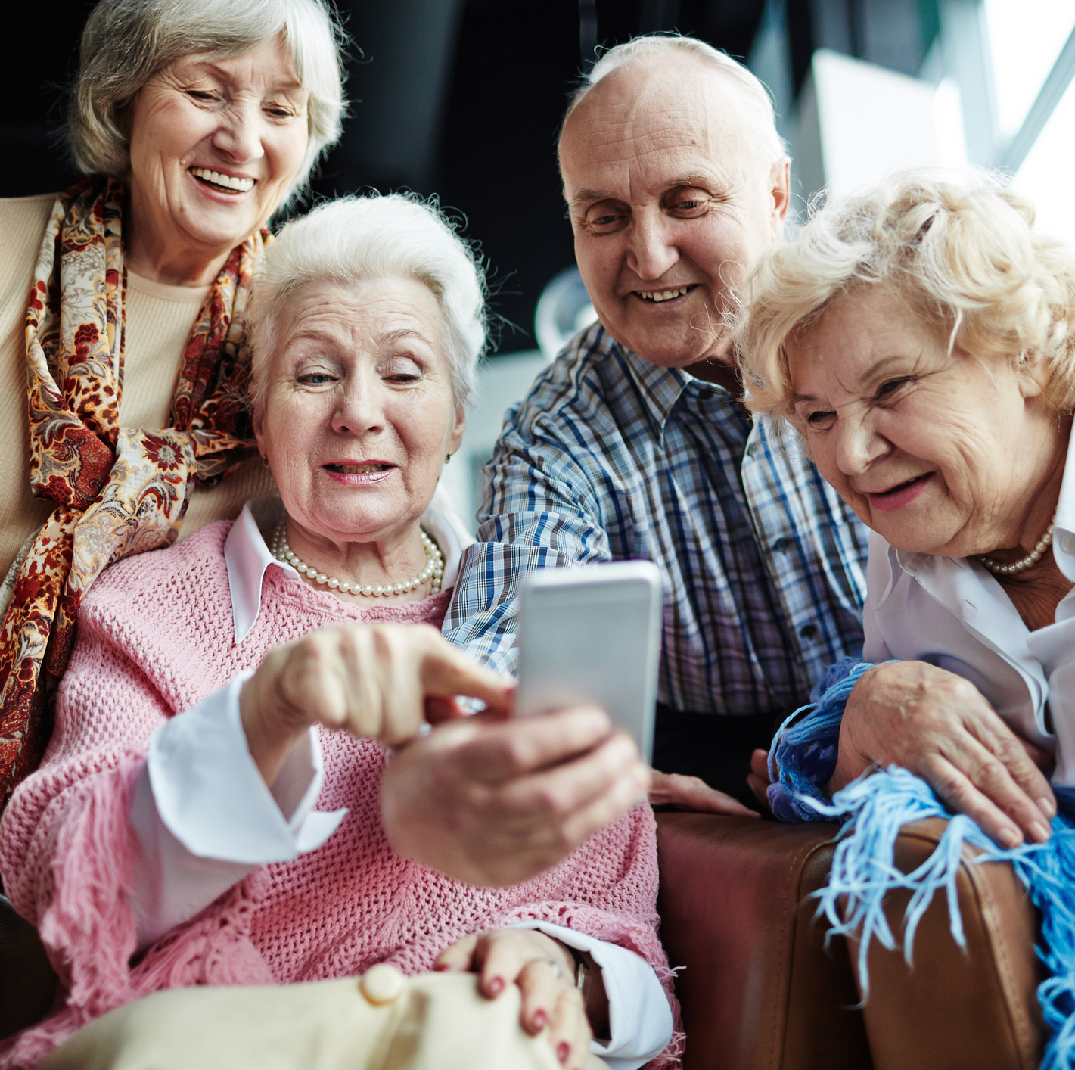
Simple Rules to always Follow!
Always ask for consent if you’re taking a photo of someone, even if it’s family or someone you may know. We don’t want any legal problems!
Public Photo Taking does not require consent, but always respect someone’s personal space.
Property Photo Taking does require consent from the Owner.

Slide 3
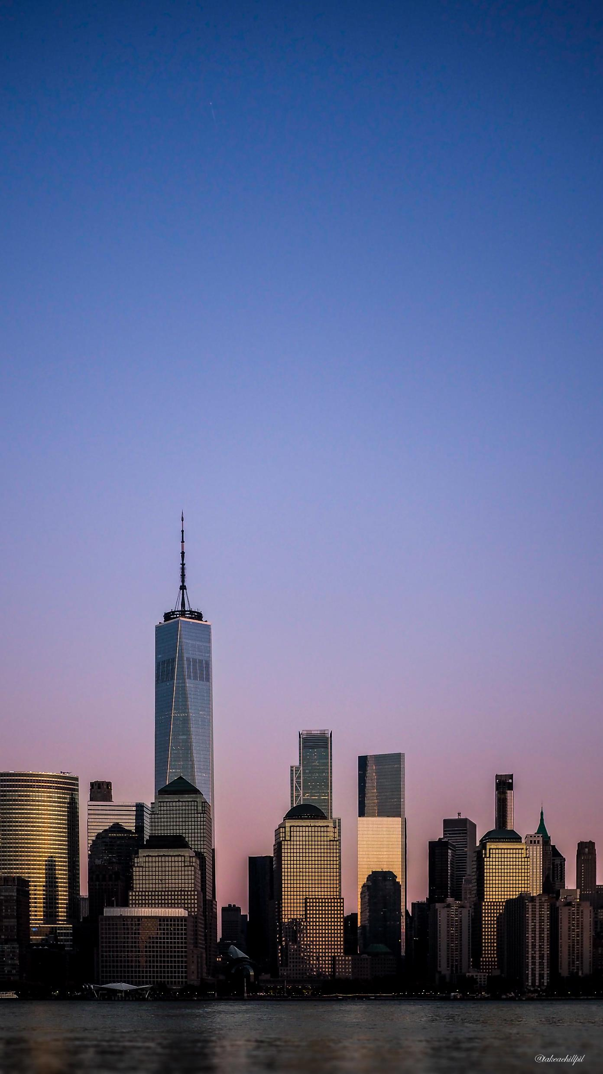
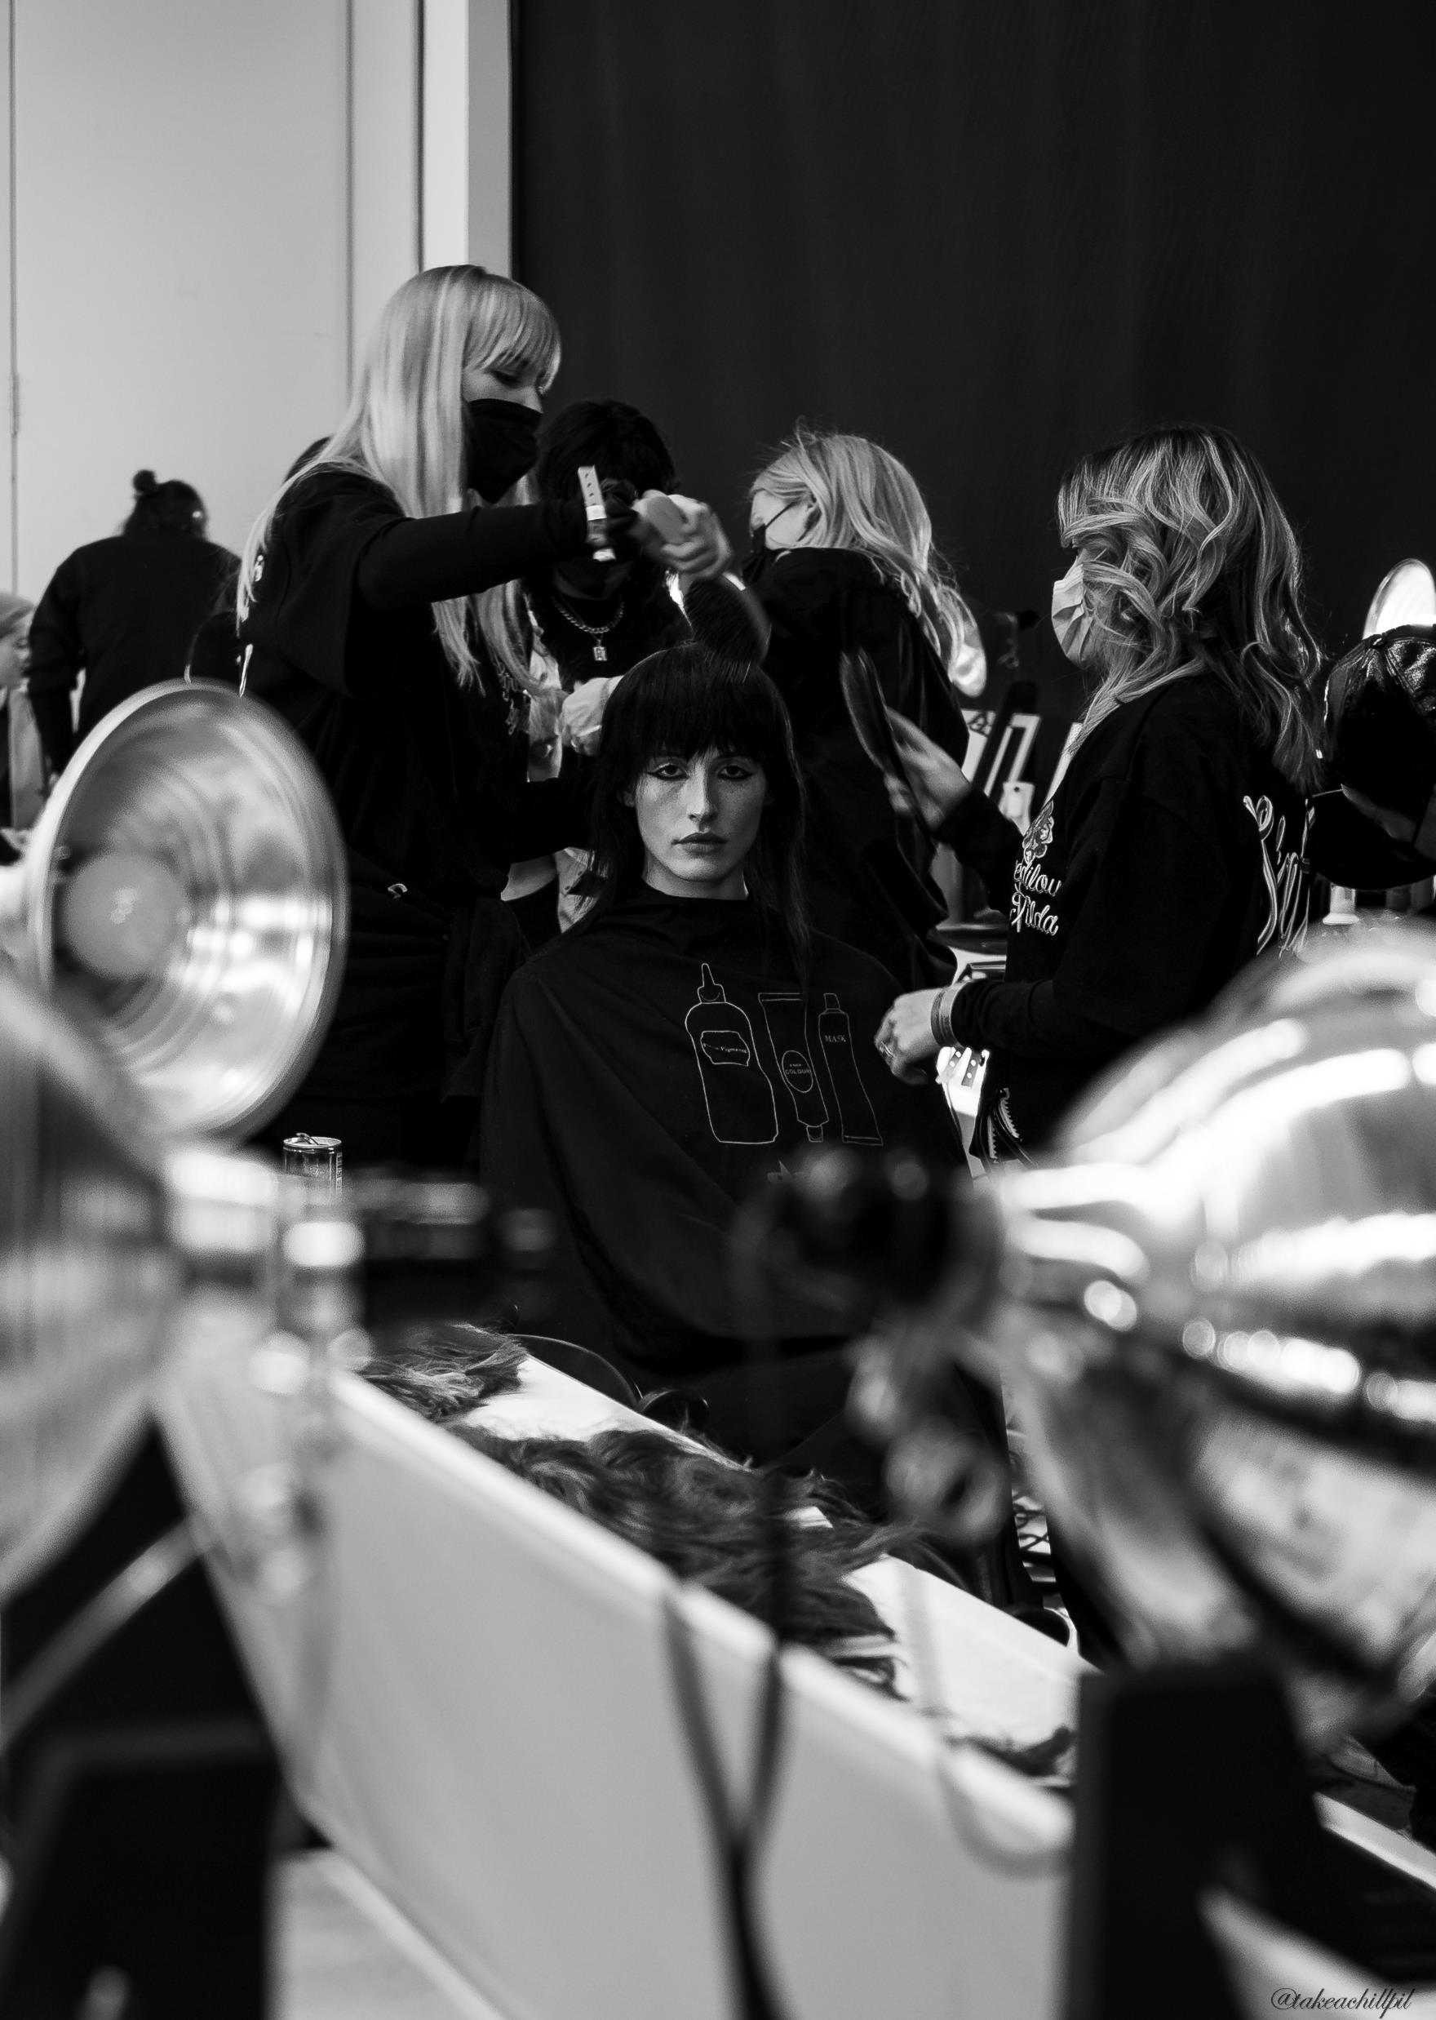
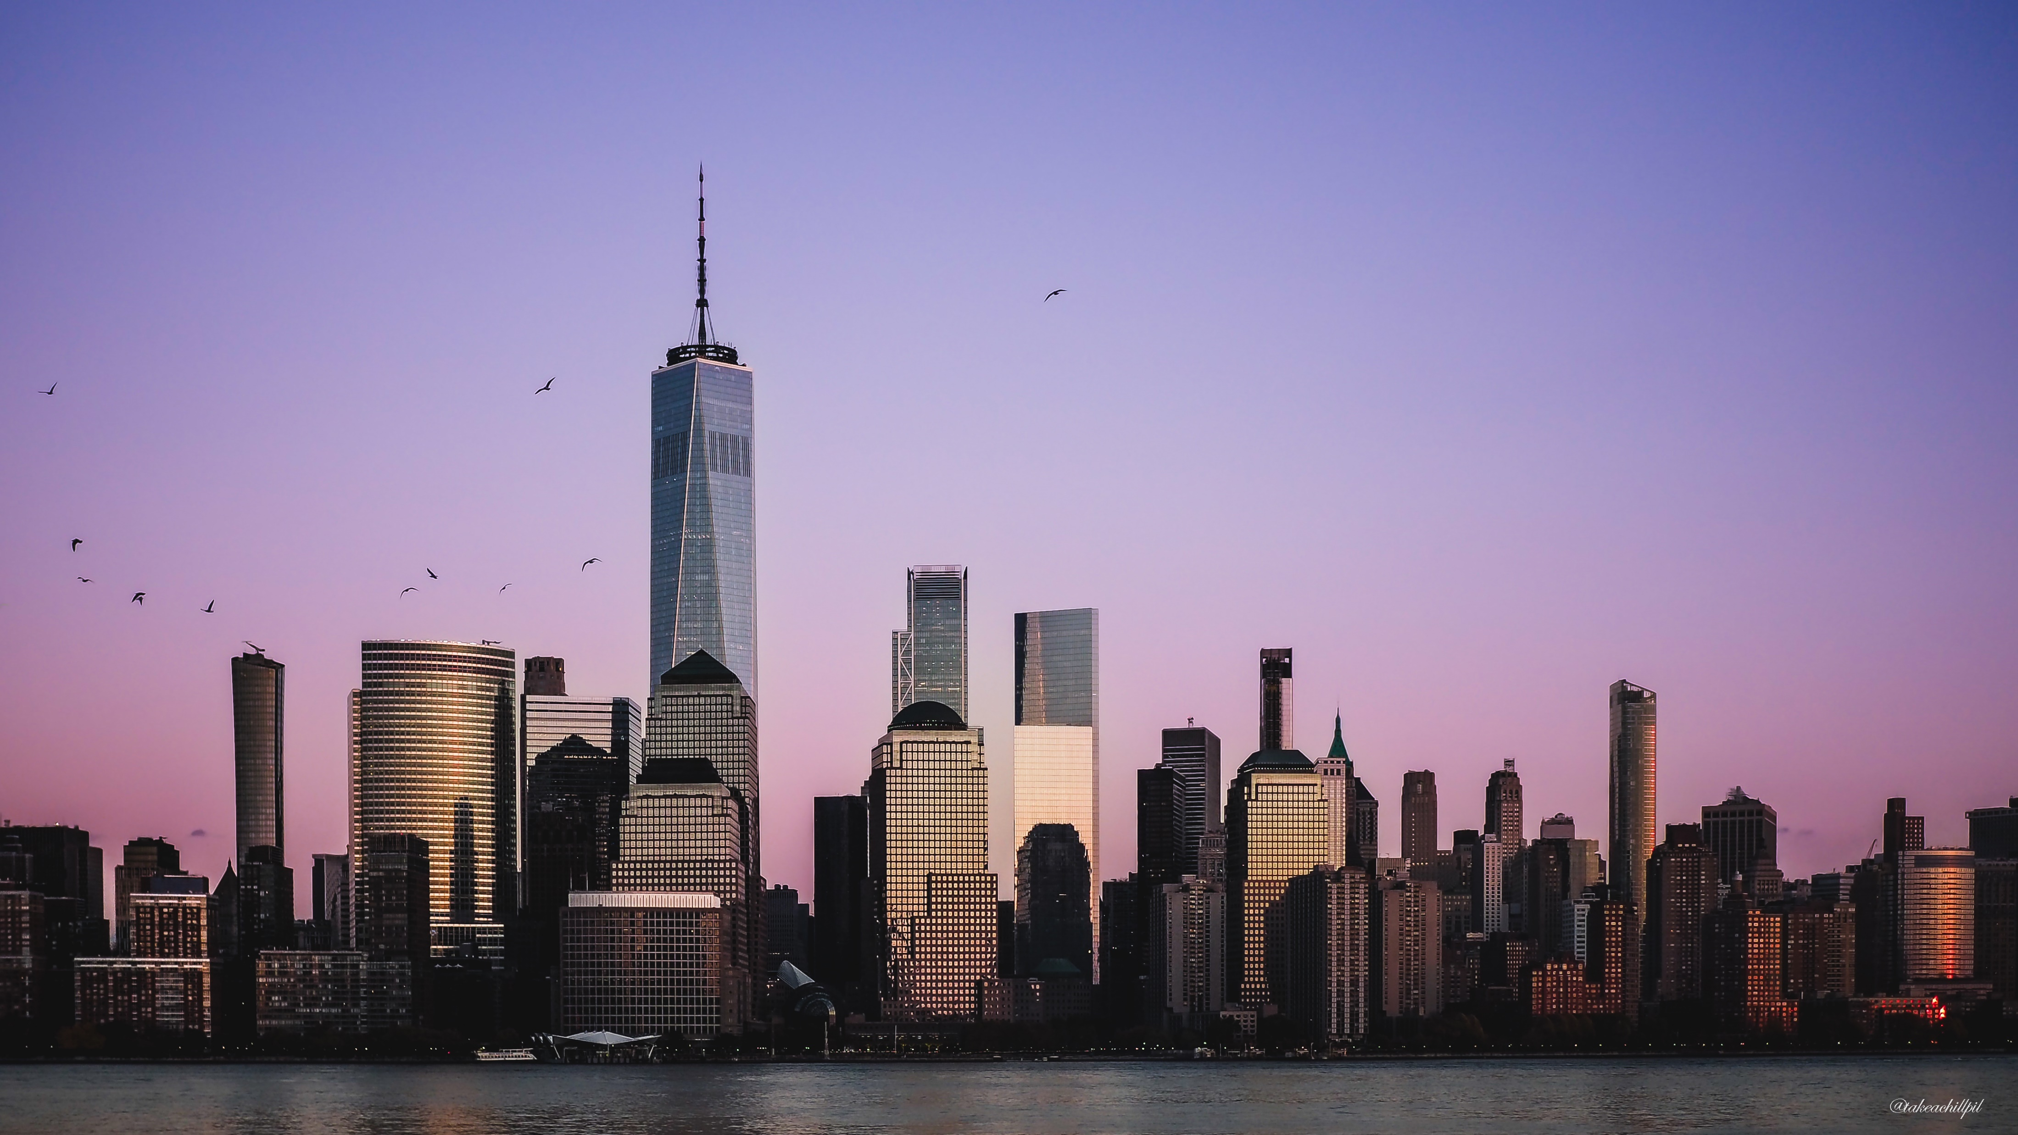
Portrait vs. Landscape
The orientation of a photo can greatly influence the overall mood.
Meaning the same image can have a completely different effect depending on its orientation.
Portrait is vertical and is commonly used for reading documents or viewing mobile content.
Portrait photos are often used to capture a person or group of people and can be taken in a variety of settings.
Portrait photos can emphasize a subject's height, stature, or details, and can create an intimate connection with the subject.
Landscape is horizontal and is often used for panoramic views, gaming, or watching videos.
Landscape photos are often used to capture the scenery of a place, such as a landscape, beach, or cityscapes.
Landscape photos can capture the breadth and context of a scene and can provide a broader perspective.
Landscape is also the best way to take videos.

Slide 4
Subject of Photo.
Find something you would like to take a photo of. It can be anything from food, flowers, people to pets. Anything can be a subject.
Centering your subject is a key start for beginners.
Filling a frame end to end on a screen with the subject is a bit more for difficult and should be used once you understand how to fill a frame correctly.

Slide 5
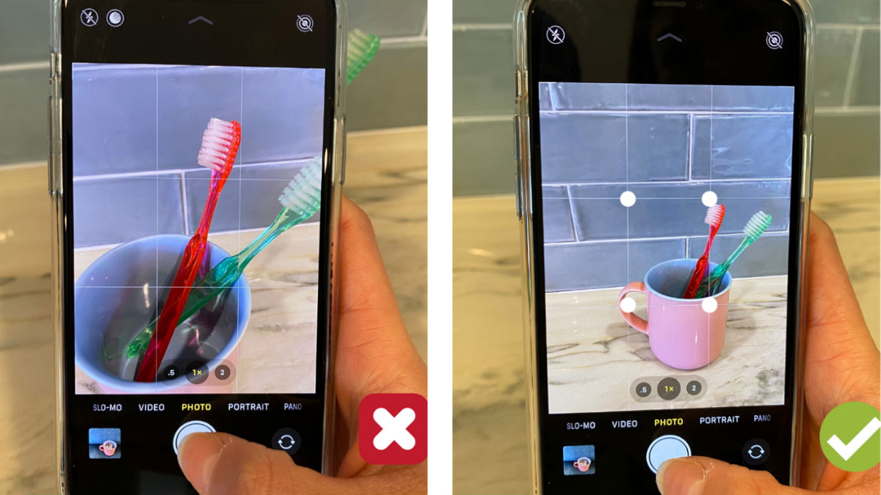
How to fill the frame.
Sometimes a photo does not come out the way we would like it to and that’s because of overcrowding of the frame.
Try not to overcrowd your whole screen with what you want to take a photo of unless it’s a document.

Slide 6
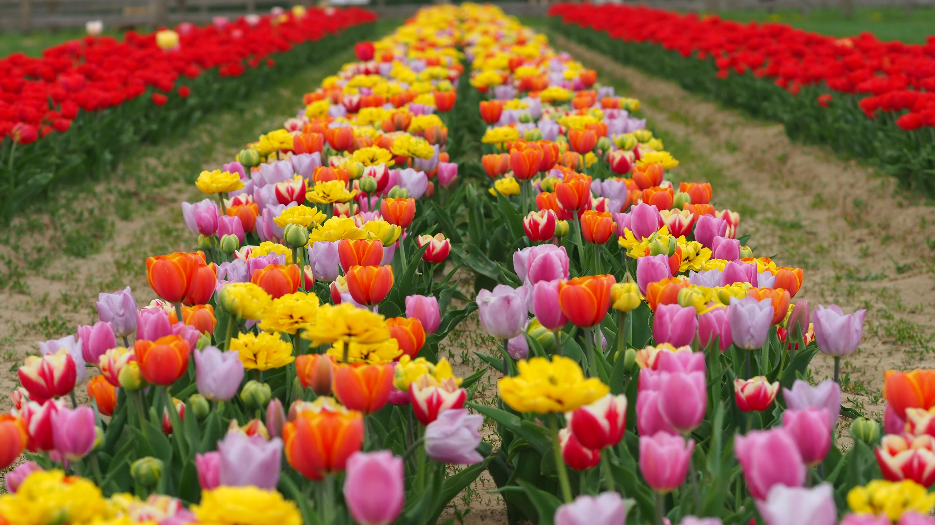
Smartphone Posture!
Straighten up your phone so it is parallel with the subject, whether you’re taking the photo Portrait or Landscape.
A natural tilt will happen depending on the subject distance from the camera. Like in this photo.
Adding more tilt-shift with your smartphone will cause the photo to look unnatural.
We can always add tilt and subtract tilt with editing but that will be discussed in a later class.
Don’t be discouraged if there is tilt. Every photo matters! We can always fix it later!

Slide 7
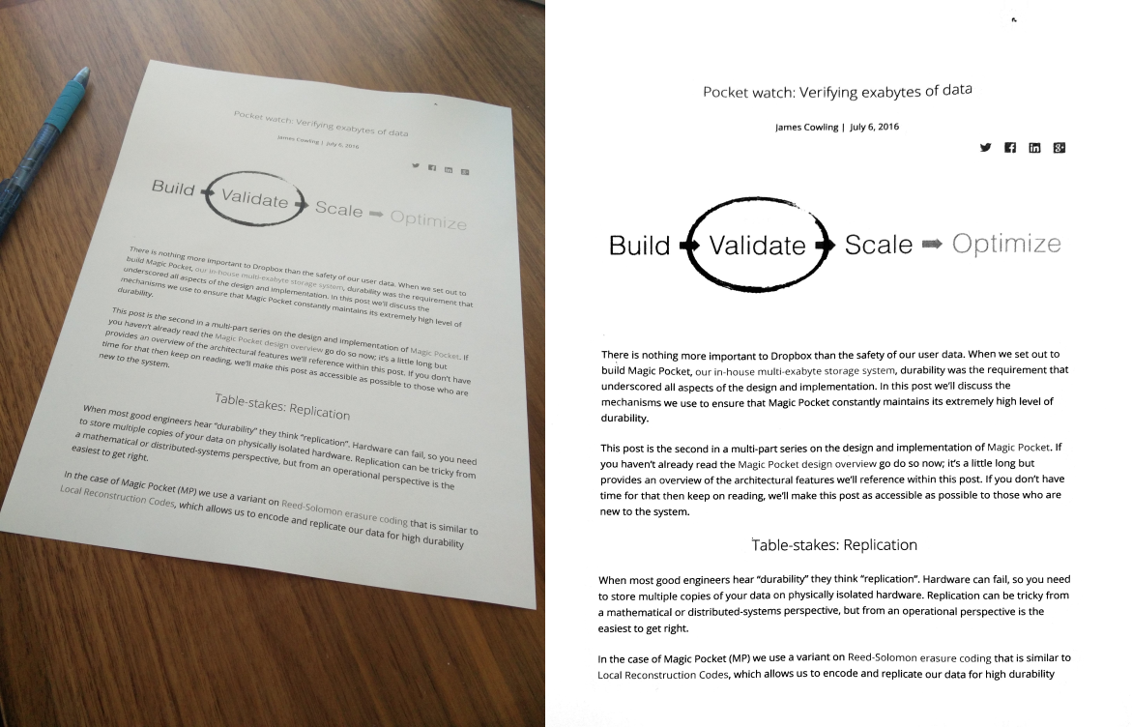
Document Photos.
Many of us take photos of Documents because we share it with family or send emails to our medical offices.
We want to take the photo of the document from above, so we capture the entirety and clarity of the document.
If we take the photo from a side angle, parts of the documents may end up blurry or cut off.

Slide 8
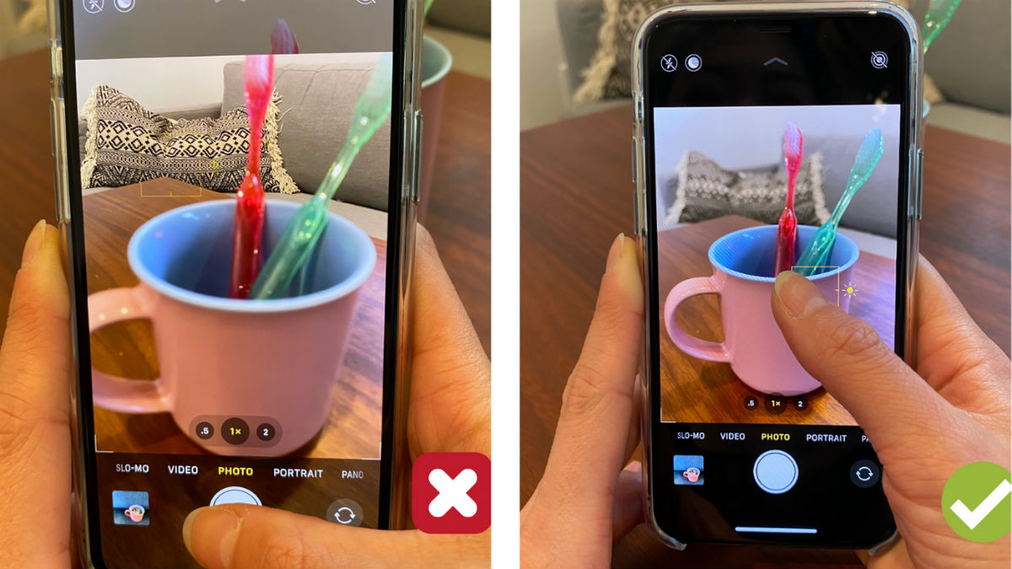
Tapping the Subject.
Using your finger tap on the subject that you’re trying to take a photo of.
This will allow the smartphone to autofocus on your subject for a clearer photo.
This also goes with document photos. Tap on the middle of the document so your smartphone focuses on the document.

Slide 9
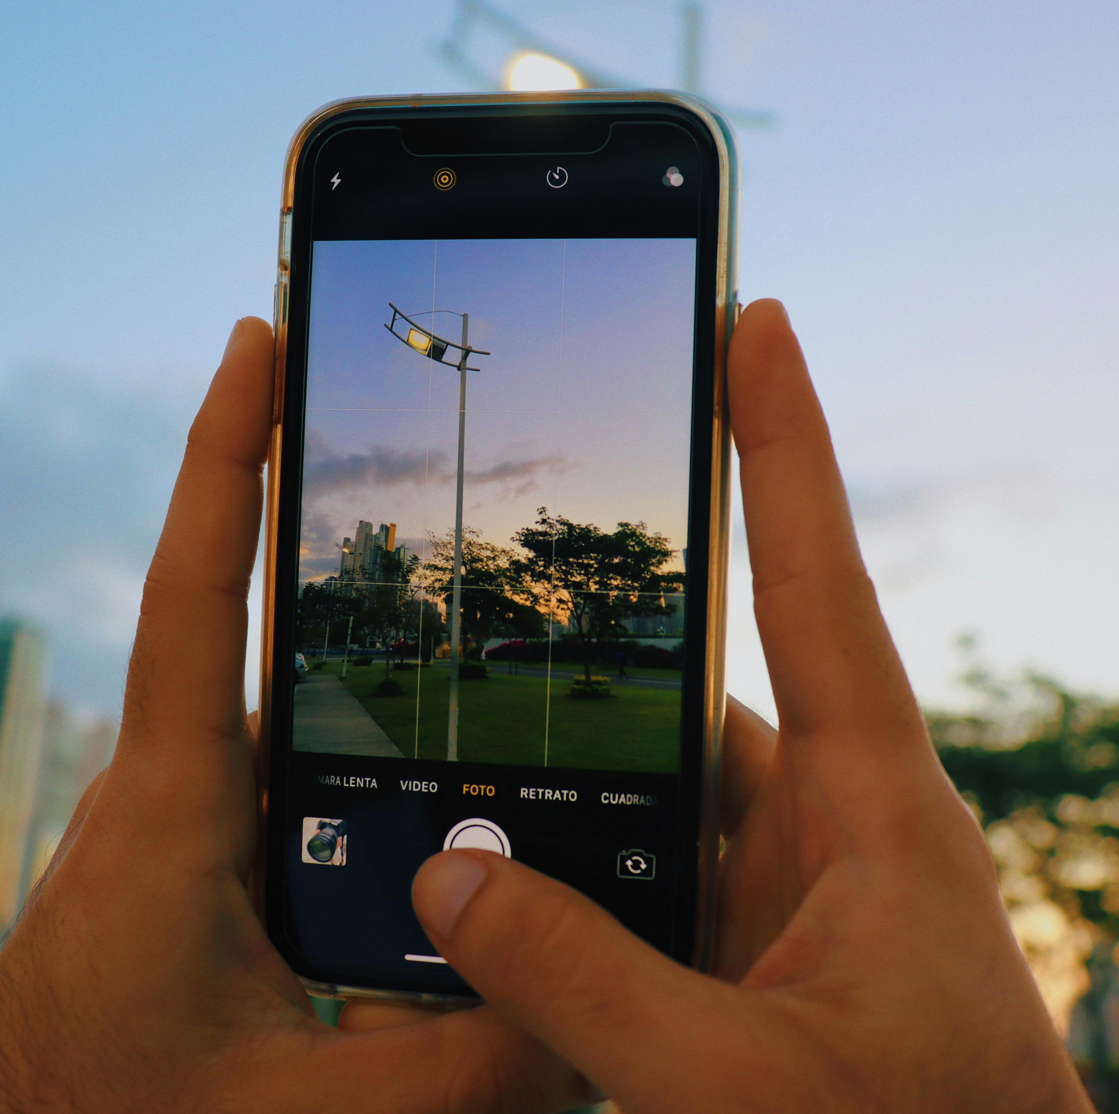
Hold Steady Now!
Many people ask after taking a photo,
“Why is this so blurry?”
Sometimes it’s because you click & move right away. It all depends on the phone you have. Some phones process photo’s a little bit slower than others.
Hold the phone in place for a few more seconds after taking your shot. *Give it 2-3 more seconds.*
*You may also have a dirty lens. Using a glasses cloth to clean it may also help reduce blur.*

Slide 10
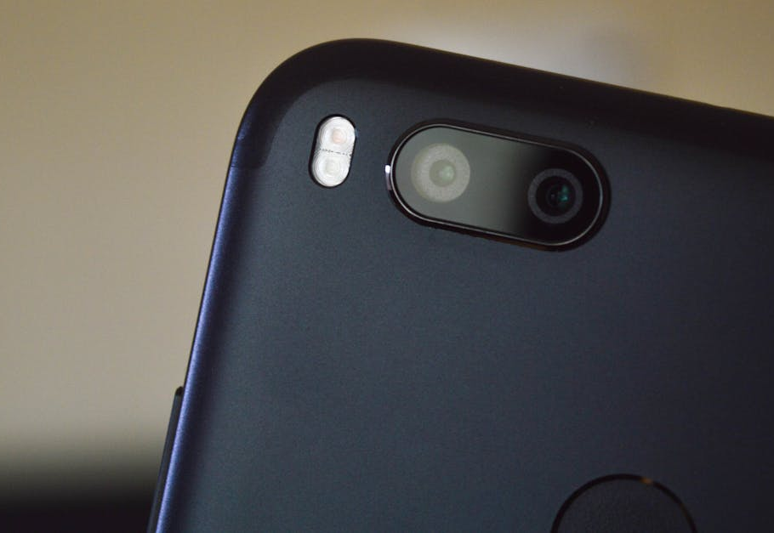
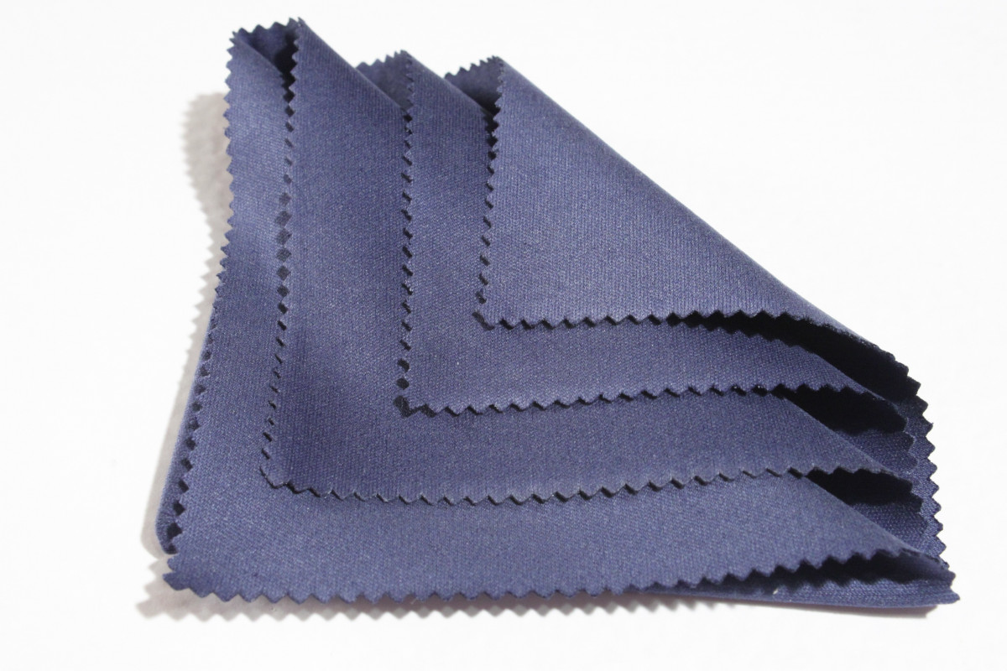
Microfiber Cloth!
If we wear glasses, we should luckily have one of these nearby!
Use this cloth to clean the camera lens on the back of your phone.
A cleaner lens will give a more detailed photo and less of a blurry effect.

Slide 11
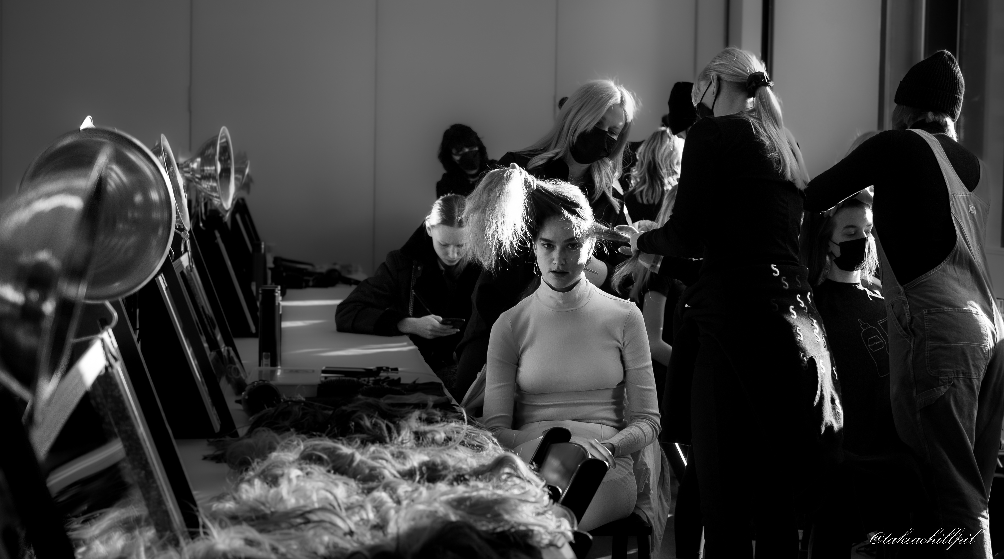
Let’s Take Some Shots!
Practice Practice Practice

