Slide 1
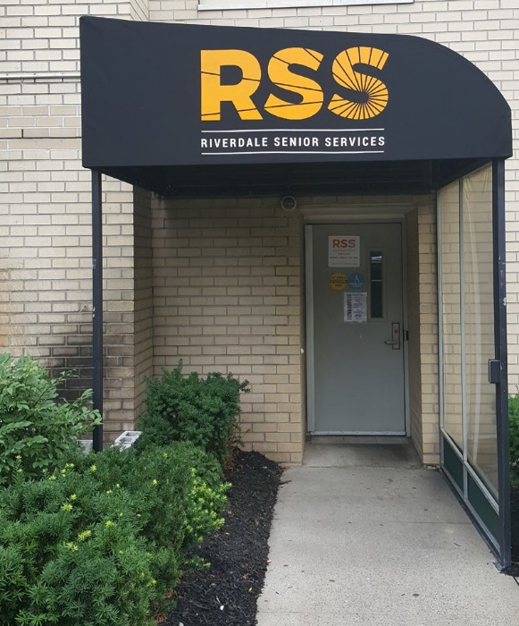
After 47 years of service, RSS continues to champion older adults and their families giving community members the opportunity to live better, happier and healthier lives. FY 21 was shaped by the Covid 19 pandemic, the most challenging situation RSS has encountered. During this unprecedented time, RSS ensured that our members were safe, connected and informed.
Board Annual Meeting
November 8, 2021
Annual Impact Report FY 21

Slide 2
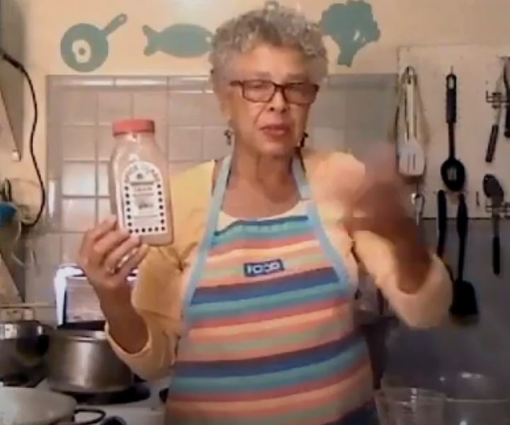
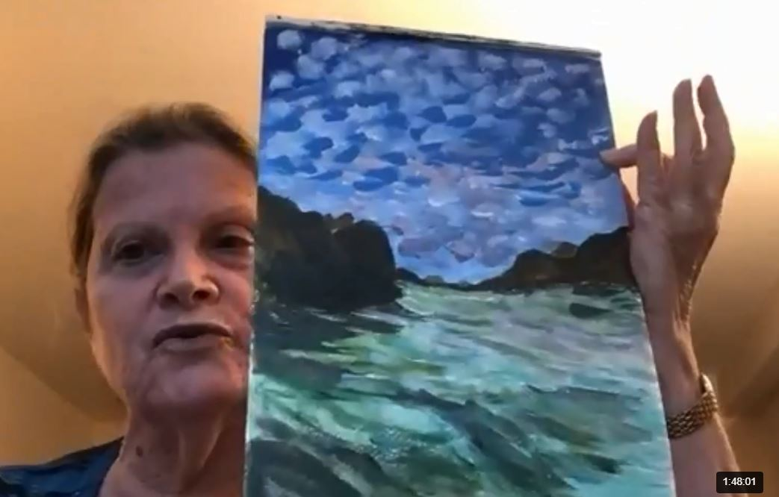
Covid Response RSS A Virtual Center
For all of FY21 RSS’s “physical doors” remained closed due to the pandemic. During this unprecedented time, RSS’ commitment to our mission didn’t change. RSS’ goal was to keep our members, safe, connected and informed. RSS expanded its virtual programming and continued to provide much needed assistance to our clients. Food insecurity challenges, accessing vaccinations, and addressing the issues of social isolation were key components of these efforts.
RSS continued to make a difference in the lives of older adults in the Northwest Bronx providing mission critical services during the COVID pandemic. While no longer able to provide on-site group activities, RSS provided key social work and mental health services, as well as, virtual programming. In FY 21 RSS staff and volunteers made over 16,000 wellness calls to our clients. RSS offered over 50 classes a month engaging an average of 500 people per month. These vital classes keep older adults physically fit and emotionally engaged.
https://rssny.org/classes-calendar.html
Virtual programming gives us the opportunity to reach a wider cohort of older adults both locally and throughout the city and state.
Deputy Director, Andria Cassidy, RN oversees center operations ensuring compliance with city contracts. She supervises center staff her clinical skills are invaluable. In addition to the center Andria oversees our Geriatric Mental Health Initiative and the Healthy Communities Initiative, as well as, the Northwest Bronx Food Justice Program. Her background in adult education makes her invaluable in designing programs.

Slide 3
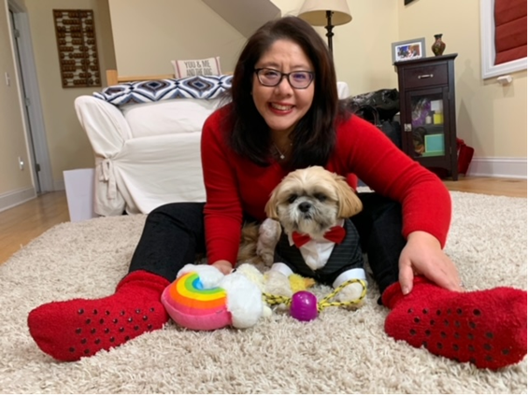
Covid Response RSS A Virtual Center
Our Social Worker, Selina Ng, LMSW, facilitated Caregiver and the Savvy Solos Support Groups, as well as our very popular program Zooming with Foo Foo!
RSS was an authorized enroller for the NYC Get Food Program. RSS was able to ensure members received nutritiously balanced meals. Staff reviewed the quality of food bi-weekly and was able to advocate on the member’s behalf if there were issues. RSS assisted over 250 members throughout the year. This emergency food program served the needs of those older adults who no longer could shop or attend a congregate lunch program due to the shelter in place order.
RSS provided information and resources on the Covid vaccine and assisted the frailest clients in securing appointments.
Two of our staff, Selina Ng, LMSW and Audrey Swanson, were trained to use the dedicated portal “Connect” for vaccine appointments for the NYP Armory Vaccination Center in Washington Heights. In an effort to reach community residents NYP allocated appointments to local community organizations including RSS. RSS collaborated efforts with NY Presbyterian Hospital & Assemblyman Jeffrey Dinowitz to schedule over 100 COVID vaccinations to individuals who struggled to get an appointment.
Our Social Services staff provided the following services
 | Units of Service | # of Unduplicated Clients
Case Assistance | 1004 | 244
Info& Referral | 623 | 623
Telephone Reassurance | 5769 | 822
Wellness Checks | 1577 | 987

Slide 4
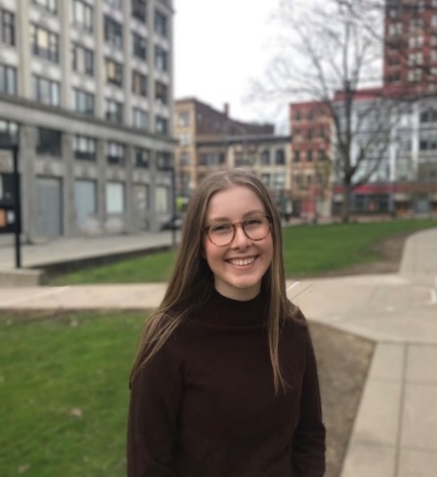
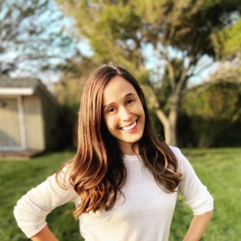
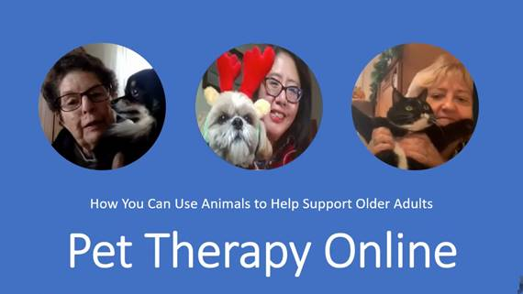
Covid Response RSS A Virtual Center
RSS was honored to present Pet Therapy Online to the Live-On Virtual Conference on January 27, 2021. It was a great success and other senior centers have incorporated Pet Therapy Online as one of their programs.
RSS staff Margie Schustack and Selina Ng presented at the LiveOn NY Virtual Conference: Pet Therapy Online: How You Can Use Animals to Help Support Older Adults, Riverdale Senior Services (RSS)
Margie and Selina were joined by Zenithson Ng, DVM, MS, DABVP Clinical Associate Professor |University of Tennessee, College of Veterinary Medicine and of course Foo Foo!
Our Social Work interns, Michelle Falco and Sarah Swinson, had regular contacts with isolated members struggling with grief and other challenges. They planned a "Life is a Journey" series of programs via Zoom. Topics included mindfulness meditation, self-care, and setting goals for the New Year. Sarah organized the Pandemic Pen Pals program connecting our members with young people via writing letters.

Slide 5
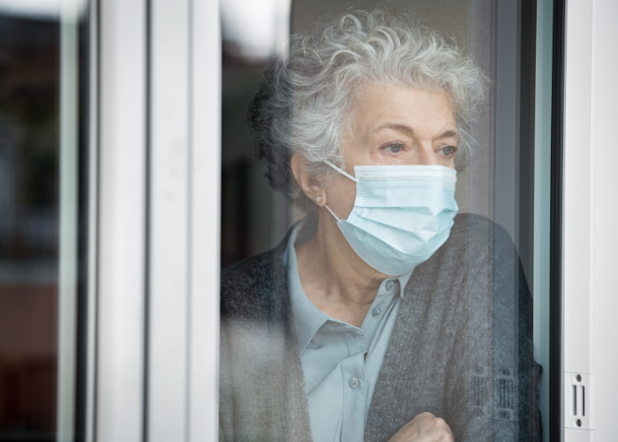
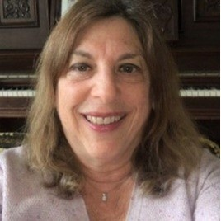
Covid Response RSS A Virtual Center
In FY 21:
280 clients were screened for depression and substance abuse
140 were screened for anxiety
120 people participated in over 600 counseling sessions
75 people participated in over 88 group counseling sessions
The RSS Geriatric Mental Health Initiative provided individual & group supportive counseling to members experiencing anxiety, depression, grief, family issues, health concerns and other problems. During FY21, the focus of clinical work was helping RSS members and others cope with the anxiety, stress, uncertainty, and isolation of the pandemic. Older adults were among the most impacted by the pandemic both in terms of mortality and also loneliness. To be protected from infection, older adults were often isolated in their apartments, cut off from friends, family, the senior center, and their familiar routines. Those who were not technology savvy were even more cut off. The negative impact on mental health was very evident and widespread.
To help our members find ways to cope more effectively, the clinical social worker conducted a series on Zoom meetings, called “Anxiety in the Time of Covid”. The six workshops, covered topics such as managing anxiety, dealing with the holidays, self-care, and the uncertainty of health information. Coping strategies, breathing exercises, practical suggestions, and health promotion recommendations were provided. Participants were encouraged to share their own experiences and ways of coping. The workshops were well attended.
The RSS clinical team, including Susan Cohn, LCSW, was a lifeline to many lonely and isolated older adults who looked forward to their counseling sessions and check-in calls.

Slide 6
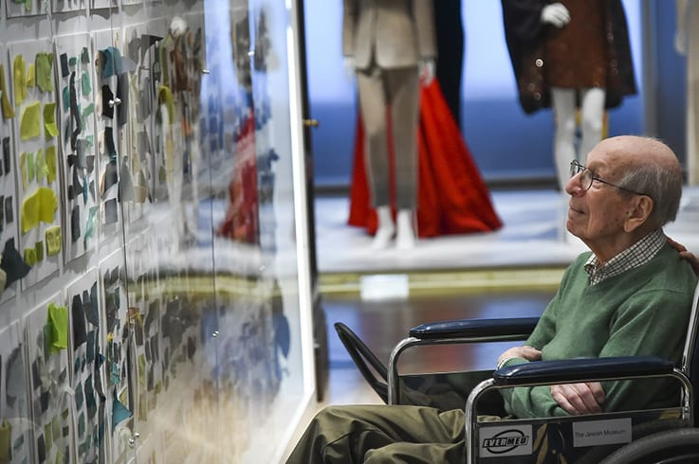
Covid Response RSS A Virtual Center
During the fiscal year 2021, the Adult Day Program for Memory Loss offered nearly 1000 hours of virtual programming via Zoom to vulnerable RSS members with Alzheimer’s disease and other dementias. Our programs included group socialization, art activities, music, and physical fitness, as well as individual interactions.
Program staff also provided vital emotional support to their families and caregivers coping with increased stress and isolation during the COVID-19 pandemic. The RSS Center for Early Memory Loss had a partnership with The Jewish Museum for a series of art workshops tailored for people with dementia and their caregivers. Students from Columbia Occupational Therapy will again do an internship at RSS focusing on a caregiver-oriented program. The ADAP team is led by Audrey Swanson, LMSW, and is supported by team members Purnelle Henry and Renee Williamson.

Slide 7
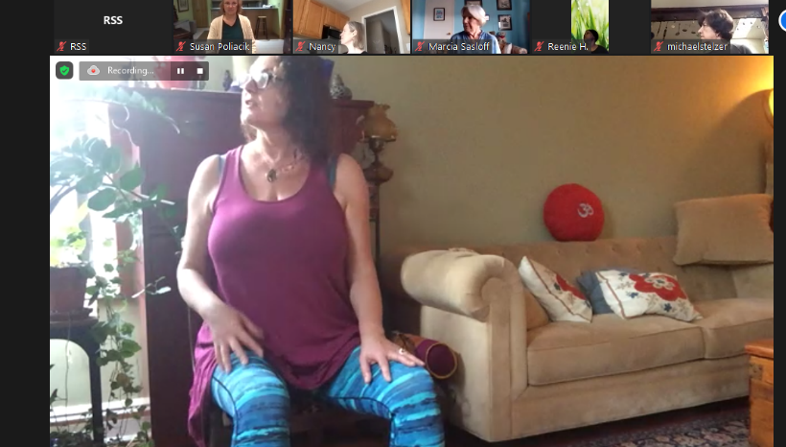
Covid Response RSS A Virtual Center
Delivering Courses Online:
RSS delivered over 150 classes each month engaging an average of 500 participants on a monthly basis by the end of FY21. These vital classes keep older adults physically fit and emotionally engaged.
Class statistics
170 classes per month (June 2021 as example), over 2,000 classes for the year
3,000 attendees of classes (could be the same person multiple times)
500 individuals per month
Special Programs
• Developed a comprehensive online creative arts program including weekly art classes with April Lombardi that average 60 attendees a week, alliances with a variety of museums including the Metropolitan Museum of Art, Ringling Museum, concerts by the Flume Ensemble (Riverdale Country School), monthly film lectures and more.
• Developed Sunday programming to reduce social isolation over the weekend.
• Comprehensive nutrition and health program including presentations by the DFTA and our own nutritionists in coordination with the NW Bronx Food Justice Coalition as well as medical presentations by NY Presbyterian doctors.
• To further enhance our offerings over the weekend and with technology we partnered with GetSetUp an online learning program. This was a free partnership. GetSetUp was so well thought of that it is now offered through the NY State Dept of Aging as a free platform for all older adults.
Margie Schustack, Director of Marketing and Programming spearheaded our virtual programs.
Chair Yoga

Slide 8
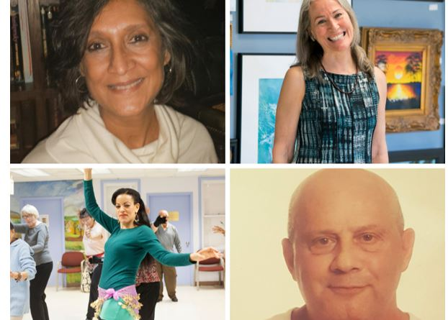
Covid Response RSS A Virtual Center
Connecting and Engaging our Clients and the Community
Our staff Margie Schustack, Director of Communications & Programming, Maritza Silva, Activities Coordinator, and Betty Begley, Executive Assistant devoted their expertise to making sure our clients were engaged.
Newsletter
Deployed weekly
Average open rate for a nonprofit email is 20%, ours is 40%.
Our average click rate is 29% approximately 3 times above average.
Website - 3,000 visitors a month, 9,000-page views
YouTube
Launched YouTube channel - over 100 subscribers, over 100 videos posted, some with more than 1,000 views
Over 400 subscribers who have requested a daily email covering our online events
Online Fundraisers with April Lombardi, Art Instructor- each raising over $5,000
Emails & Newsletters
Over 600 emails deployed in FY’21
Weekly newsletter reaches over 2,500 people with 50% open rate (nonprofit industry average is 20.39%)
Focused in our communications (newsletter, seminars and more) on key community/national initiatives including filling out the census, COVID vaccinations, food insecurity, and in collaboration with the Riverdale Y Senior Center sponsored forums for city council candidates.

Slide 9
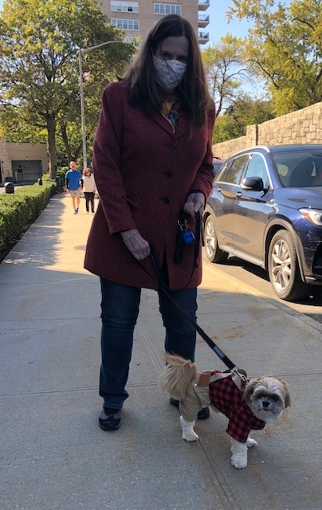
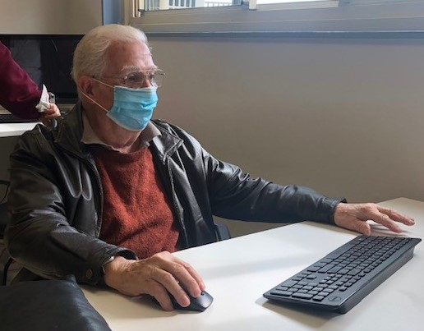
RSS Volunteers
Volunteerism during a pandemic was very challenging. Nevertheless, our volunteers stepped up to the plate and adapted to the challenges, and helped reshape the landscape of RSS. They continued making a difference demonstrating how flexible, tough and resilient they are. Fifteen Volunteers provided Wellness Calls keeping our members in touch with RSS and connecting RSS staff with those who needed assistance and helping members feel less socially isolated and lonely. Our “phone squad” of volunteers and staff surpassed the 16,000 mark in terms of the number of wellness-check calls made.

Slide 10
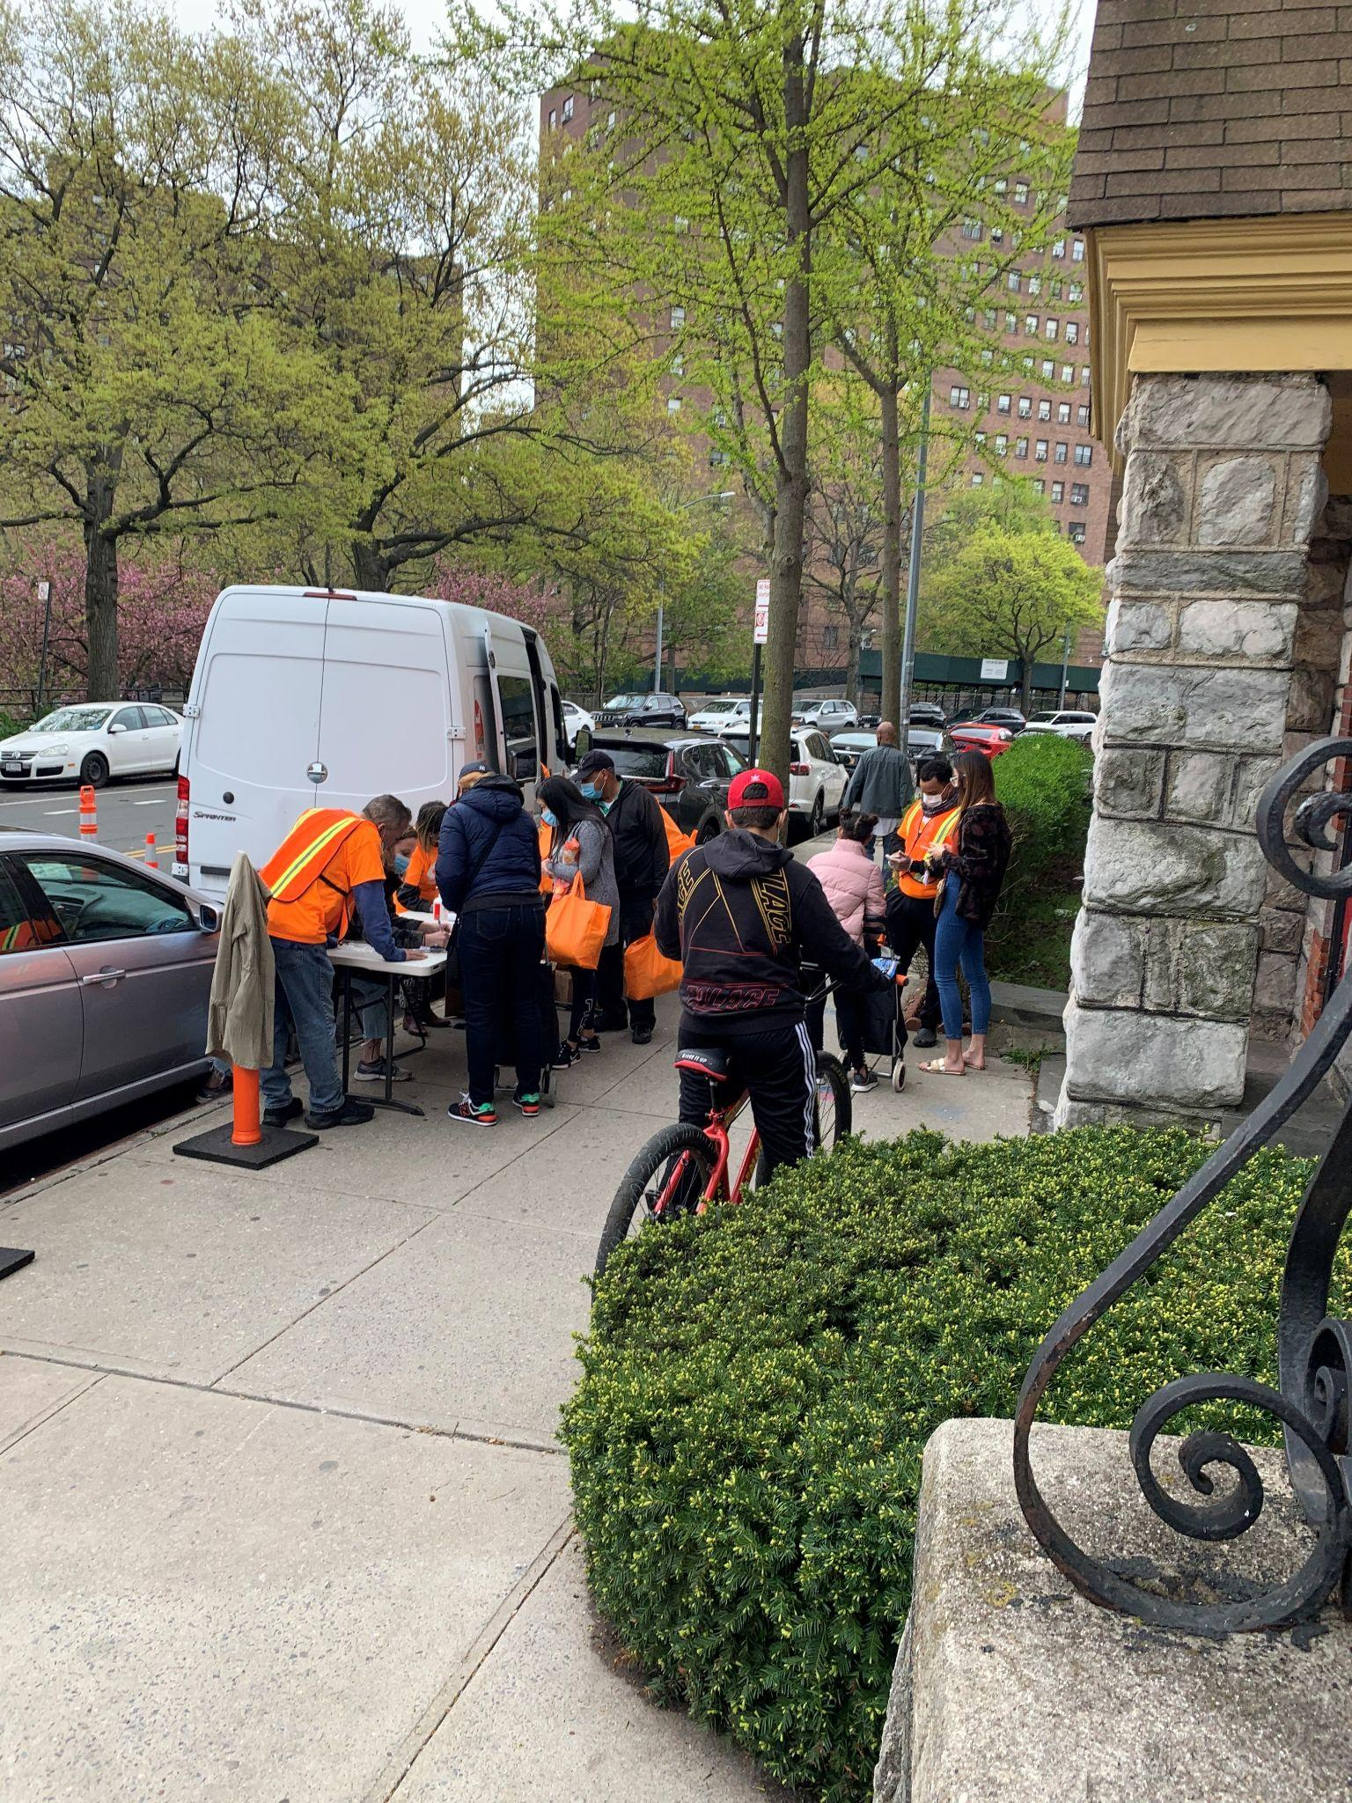
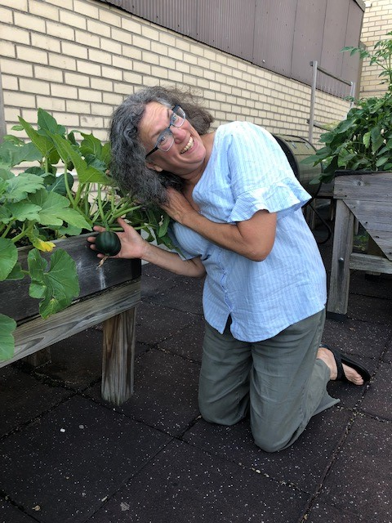
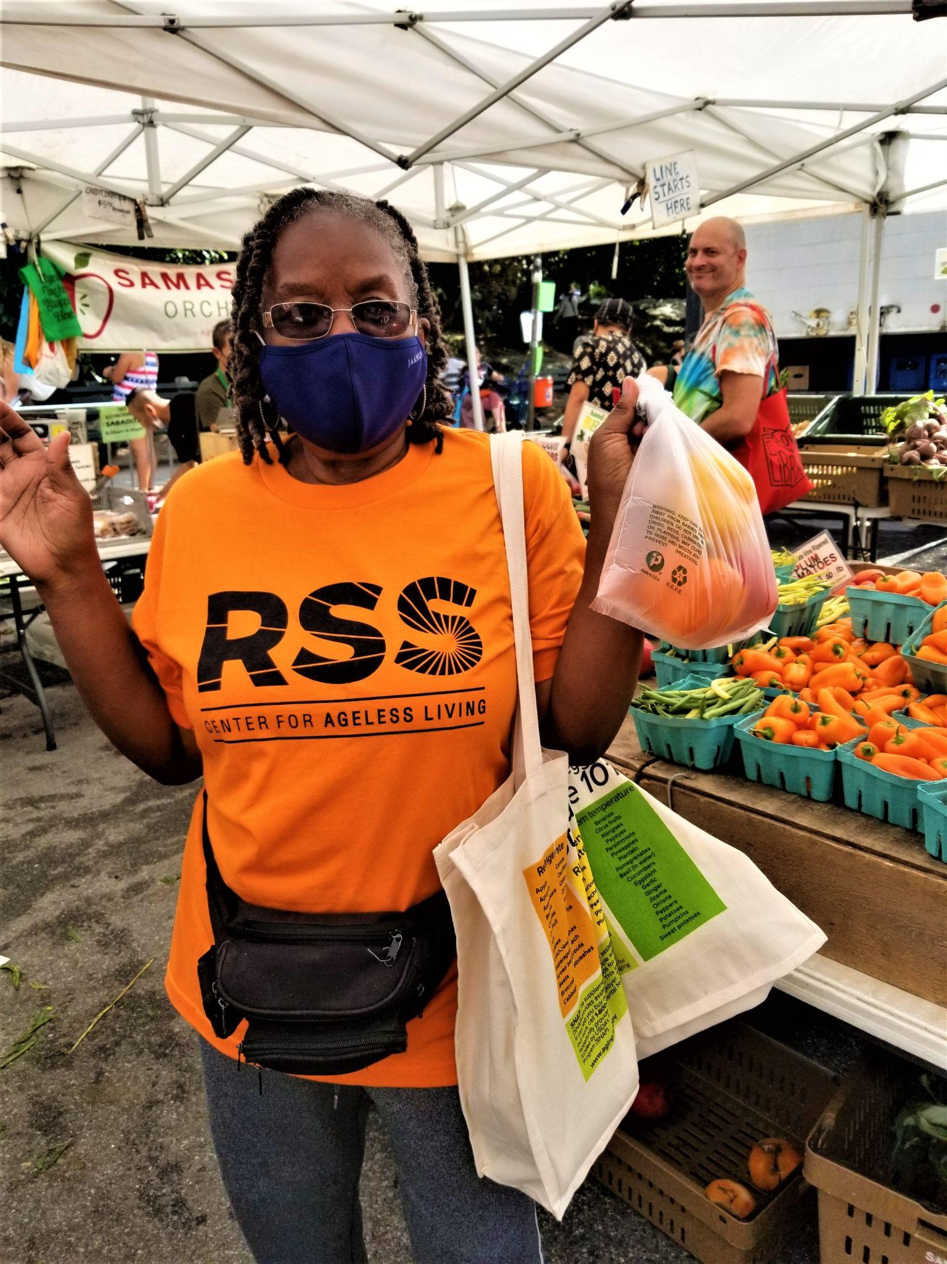
FY 2021 Highlights Healthy Communities Initiative
The Healthy Communities Initiative (HCI) provides coordination of resources to address health disparities in the surrounding neighborhoods. HCI expanded its coalition (now called the NW Bronx Food Justice Coalition) of local community organizations and residents of Riverdale, Kingsbridge, and Marble Hill. The Wellness Team, including a Community Health Nutrition Educator, Registered Dietician, Community Outreach Coordinator, and a Registered Nurse, provided community- based workshops on maintaining health and managing disease through nutrition. This outreach supported community members in understanding the interaction of healthy eating with maintaining health and wellness. Program highlights include:
Monthly online and in-person nutrition and cooking workshops
6 nutrition and wellness programs were broadcast on BronxNet TV in partnership with coalition partner Outer Seed Shadow
Partnered with local organization Bronx Eats to do an online cooking series
Created a monthly Healthy Eating Corner e-newsletter
Distributed health and nutrition literature to the community: nutrition flyers, recipes, and a cookbook
Walk and Shop events to the local farmers’ market to combine healthy eating and exercise
The Emergency Food Pantry at St. Stephens United Methodist Church became sustainable by working with an established food pantry, Love Kitchen, and other community partner organizations to distribute fresh produce and dry goods (beans, rice, etc.) to approximately 1000 people in FY 2021
Increased the number of Coalition members from 6 to 8
Love Kitchen delivering food to St. Stephens emergency food pantry.
Barbara Denson is our
Horticultural therapist and is an integral part of the HCI and the NW Bronx Food Justice Project.
Health Nutrition Educator, Deborah Johnson on BronxNet TV. Community member at a Walk and Shop Farmers’ Market Event.

Slide 11
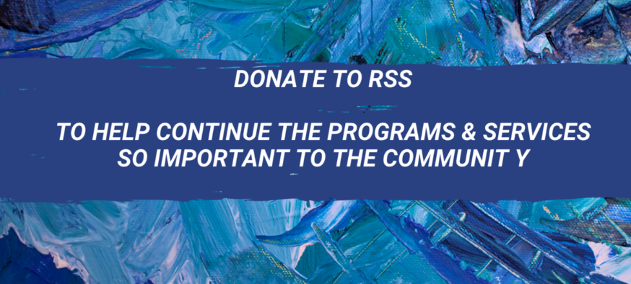
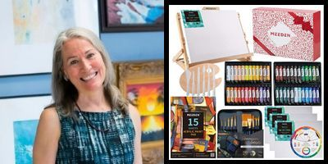
Fundraising
Fundraising | Budget | YTD Actual as of 6/30/2021 | Campaigns
Member Appeal | $20,000 | $53,467 | Member Appeal RSS Emergency Fund Comeback Fund
Gala | $60,000 | $5,500
Annual Appeal | $30,000 | $47,862 | Community Annual Appeal Community Emergency Fund RSS Comeback Fund End of Fiscal Year Campaign
Online Special Events | $8,000 | $13,480 | Special Presentations & Workshops by April Lombardi Van Gogh Michelangelo
Total | $118,000 | $120,309

Slide 12
RSS Staff
June 30, 2021
Betty Begley Executive Assistant
Andria Cassidy, RN Deputy Director
Rebecca Cobbinah Cook Manager
Susan Cohn, LCSW Clinical Social Worker
Julie Dalton Executive Director
Barbara Denson Program Specialist/Horticultural Therapist
Kevin Everett Assistant Cook
Sharif Graham Driver
Purnelle Henry Program Aide Adult Day Care Programming
Alex Hulinsky, RN Registered Nurse
Heidi Miner Kitchen Aide
Selina Ng, LMSW Social Worker
Margie Schustack Director of Communications & Programs
Maritza Silva Activities Coordinator
Audrey Swanson Director Adult Day & Caregiver Services
Jose Torres Custodian
Yvonne Velazquez- Rosa Transportation & Volunteer Coordinator
Renee Williamson Personal Care Aide Adult Day Care Program

Slide 13
RSS Board Members
June 2021
BOARD OF DIRECTORS
PRESIDENT: KERI CRAYNE, MPH, RD
FORMER PRESIDENT: RHEA DORNBUSH, Ph.D., MPH
VICE PRESIDENT: HELEN MORIK, MPH
RECORDING SECRETARY: JOAN HAAHR, Ph.D.
CORRESPONDING SECRETARY: JUDITH KRAMER
TREASURER: ANTHONY MAHLER
ALEC DIACOU
PAUL DUNPHEY, MBA
FRANCES FREEDMAN, MSW
RUTH FRIENDLY
JOAN HAAHR, Ph.D.
MYRA KAUFMAN
THOMAS MORE KELLY, Ph.D.
MARTHA KOSYK
JUDITH KRAMER
STEPHANIE P. MERMIN, MA
LISA MOREIRA
HELEN MORIK, MPH
JOHANNA ODRICH, DR. PH
ROBERT J. RUBINSTEIN, ESQ.
IRENE SMOOKLER
HON. DAVID STADTMAUER

